Slide 1
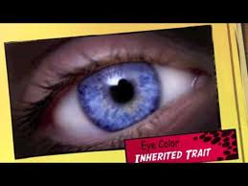
Inherited Traits and Learned Behaviors
By: Cammie’s Corner

Slide 2
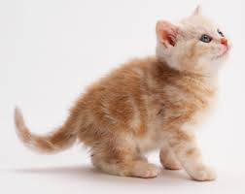
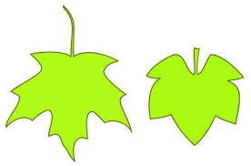
Inherited traits
Every living thing has traits that make it unique.
A trait is a quality or characteristic of a living thing
Physical features
The color of an animals’ fur
The shape of a leaf

Slide 3
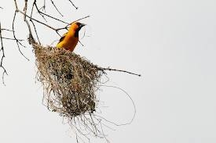
Behaviors. A behavior is a way in which living things responds to its surroundings.
Building a nest
(animal behavior)
Growing towards sunlight
(plant behavior)

Slide 4
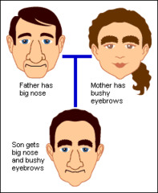
Organisms get traits in different ways.
Inherited traits- traits are passed from parent to offspring, or young before the offspring are born.
Heredity- the passing of traits from parents to offspring before birth

Slide 5
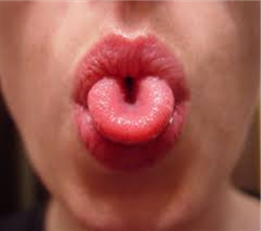
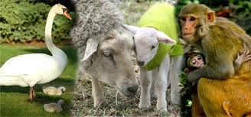
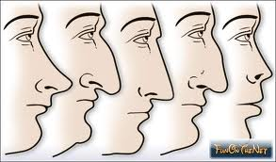
Both physical features and behaviors can be inherited.
having four legs or fur.
Barking
Color of eyes and hair
shape of your nose.
Ability to laugh or cry (humans)
Rolling your tongue.

Slide 6
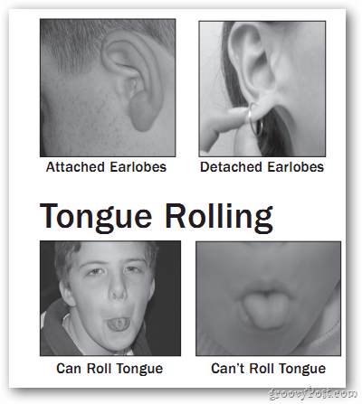

Slide 7
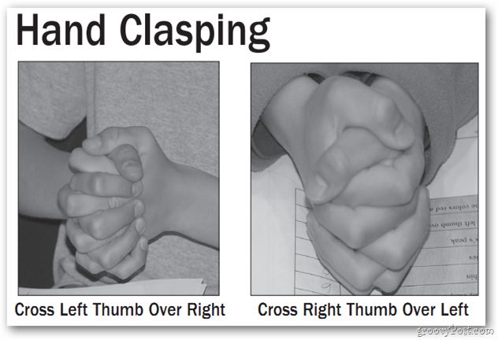

Slide 9
Like animals, plants inherit ways of responding to their surroundings.
Roots grow down toward water.
Stems grow up towards the sun
Leaves grow toward the light
Vines may climb up a fence or tree trunk.
Leaves of some plants close up if something touches it.

Slide 10
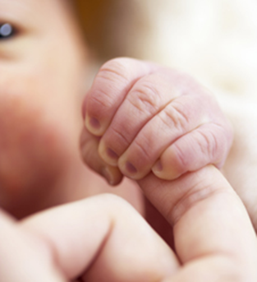
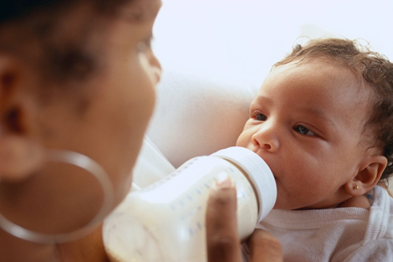
A behavior is a way of acting
These can be inherited too; they are called instincts
Babies are born with specific reflexes to help them survive

Slide 11
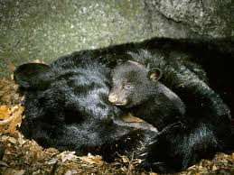
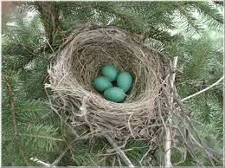
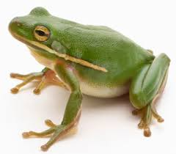
Animal instincts:
When the weather becomes cold, animals prepare for winter by instinct
Some head for warmer climates, others hibernate
Birds protect their eggs and babies
Frogs are not born with this instinct
They leave their eggs to hatch (or die)

Slide 12
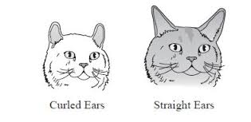
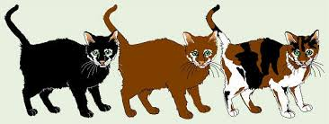
These traits are passed from parents to offspring by genes.
Genes are tiny pieces of material that contain hereditary information
Genes are located in cells and control how traits develop in a living thing.
Because of genes, offspring resemble their parents in many ways.
Apple trees produce more apple trees
Heredity BrainPop Video

Slide 13
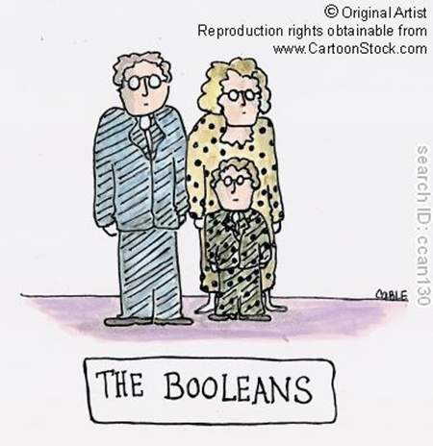
Most plants and animals get their genes from two parents.
Half comes from one parent and half comes from another parent.
traits are not exactly like those of either parent.
Genes come in pairs
Fathers have XY genes, and mothers have XX genes
One gene from the mom combines with one gene from the dad
Father Mother
XY XX
Baby
XY

Slide 14
Learned Behaviors
A learned behavior is a skill that an animal develops after it is born.
Genes do not control learned behaviors.
are not passed from parents to their offspring.

Slide 15
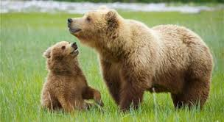
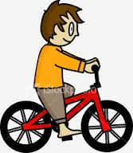
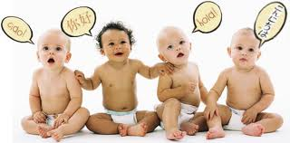
Humans and animals learn from adults and their experience.
Mother bear shows her cubs how to fish or find berries.
Bird may teach its babies to fly.
A young horse may learn to stay away from an electric fence.
Knowing a language. You learned to speak by listening to your parents or other people.
knowing how to ride a bike

Slide 16
Examples of Inherited and Learned Behaviors
Inherited Traits | Learned Behaviors
A girl had brown eyes
A girl can read Spanish
A boy has long fingers
A boy can play the piano
A bird knows where to find a feeder.
A bird eats seeds
A dog knows the sound of it’s owner’s voice.
A dog has pointed ears

Slide 17
Like learned behaviors, some physical traits are not inherited.
If you cut your hand and get a scar
A bird with a broken wing
A tree may be bent by the wind or scarred by lightning

Slide 18
Discussion Question:
Think about your own traits. What are three traits that you inherited? What are three of your traits that are learned behaviors?

Slide 19
Vocabulary – Words to Know
Trait: a quality or characteristic of a living thing.
Behavior: a way in which a living thing responds to its surroundings.
Inherited trait: a trait that is passed from parents to offspring before the offspring is born.
Heredity: the passing of traits from parents to offspring before birth.
Gene: a tiny piece of material that contains hereditary information and control how traits develop in offspring.
Learned behavior: a skill that an animal develops after it is born.

